Slide 1

S.A.F.E.G.E.N- Smart Automated Fire Emergency Gaurdian with Enhanced Notification
REC
PROJECT TITLE :
DEPT/YEAR & SEM :
B.TECH (AI&DS) / III & VI
GUIDE :
MR.V.VEERESH.,ME
TEAM MEMBERS : :
ANANDRAJ.M
KAVINSARATHI.S
SREEHARAN.P
SUMANKANTH.K

Slide 2
REC
PROBLEM STATEMENT
” Small spark can escalate into disaster ”
The DFS’s yearly data reveals that in 2023, fire calamities resulted in 59 deaths and 689 injuries. Additionally, during evacuation, the panic-induced rush adversely impacted several peoples.

Slide 3
REC
ABSTRACT
>> S.A.F.E.G.E.N is a cutting-edge fire detection system. It operates autonomously using a camera , excelling in fire recognition. It captures incident images, sends immediate SMS alerts, and detailed emails with photos.
>> Adaptable to larger environments, it integrates with existing CCTV systems. Its aiding emergency services. S.A.F.E.G.E.N is a proven solution that enhances fire safety.

Slide 4
INTRODUCTION
REC
>> Introducing S.A.F.E.G.E.N, an innovative fire detection system. It uses a camera and excelling in recognizing fires. It captures images of the incident, sends SMS alerts, and detailed emails with pictures.
>> It can integrate with existing CCTV systems in larger settings, making it versatile. S.A.F.E.G.E.N is a adaptable solution that enhances fire safety measures.

Slide 5
REC
EXISTING SYSTEM
>> Fire Alarm - Creating a sound after the fire detected
>> Smoke Alarm - creating a sound after the smoke detected

Slide 6
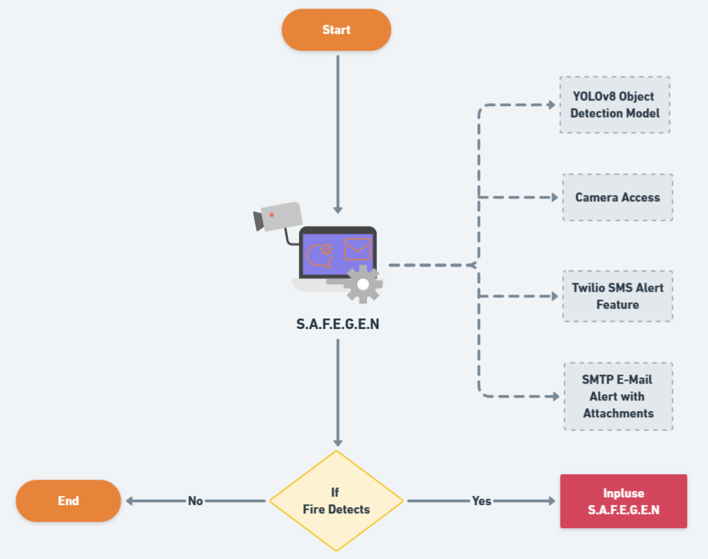
REC
FLOWCHART

Slide 7

REC
PROCESS

Slide 8









REC
TECHNICAL STACK
SMTP

Slide 9
REC
NOVELTY
>> Improving fire detection accuracy and speed
>> Reducing false alarms and their negative impacts
>> Providing real-time information and guidance for evacuation and rescue
>> Enhancing fire prevention and mitigation strategies
>> Saving lives, property, and environment

Slide 10
REC
ADVANTAGES
>> Being easy to install and operate
>> Being compatible and adaptable with existing CCTV systems
>> Being cost-effective and energy-efficient
>> Being scalable and flexible for different settings and scenarios

Slide 11
REC
CONCLUSION
>> In conclusion, S.A.F.E.G.E.N represents a significant advancement in fire detection technology. By combining autonomous camera surveillance, it not only identifies fire incidents swiftly but also facilitates a rapid response through its seamless integration with existing security infrastructure and direct communication with emergency services.
>> This system stands out as a versatile and adaptable innovation that promises to significantly bolster fire safety measures.

Slide 12

ANY
QUERIES ?

